Slide 1
Building an Investment Case for RMNCAH+N in Malawi Updates July 2018 Maziko Matemba
Notes:
We all know there are resources in the health sector. But where is it going?
And is it really achieving the results we want? i.e. Aid effectiveness.
What can we do to ensure that it does? And what role does data have to play?
Ultimately this is about a shift in thinking → We need to focus on PERFORMANCE and RESULTS. That is the goal. Now how do we get there?

Slide 2
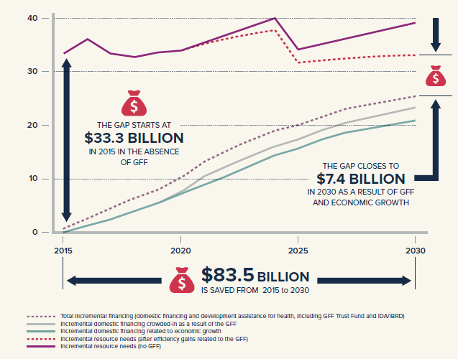
Problem: Annual funding gap for RMNCAH+N exceeds US$33 billion in high-burden, low- and lower-middle income countries
Source: Global Financing Facility

Slide 3
The Global Financing Facility works to close the gap in three ways
By generating efficiencies through smart financing
By crowding in additional domestic resources
By further mobilizing development assistance for health and improving coordination of this assistance
Source: Global Financing Facility
Notes:
The GFF Trust Fund plays a catalytic role to first to mobilize IDA financing and increasingly resources from other identified sources (domestic and external) until the country becomes reasonably self-sufficient.

Slide 4
GFF can expedite Malawi’s attainment of SDGs and national priorities by catalyzing a new financing partnership for RMNCAH+N
The Global Financing Facility in Support of Every Woman Every Child is a key financing platform of the UN Secretary General’s updated Global Strategy for Women’s, Children’s and Adolescents’ Health (2016-2030) and aligns with the SGDs.
It is a multi-stakeholder partnership that brings together, under national leadership and ownership, stakeholders in reproductive, maternal, newborn, child and adolescent health as well as nutrition (RMNCAH+N).
Guiding Principles
Country ownership
International Health Partnership principles
Emphasis on domestic resource mobilization
Efficiency
Result-focused
Source: Global Financing Facility

Slide 5
The GFF provides support to countries like Malawi through two key channels
Technical Assistance
Health financing and policy development (e.g. resource mapping, HF strategy development, etc.)
Support for Investment Case development
2) Direct grant funding (“GFF grant”)
Linked to World Bank IDA funding at 1:3 or 1:4 grant-to-loan ratio
Current IDA: Investing in Early Years (IEY) – ballpark $100M cap (TBD)
GFF grant opportunity estimated at $10-$20M over 3-5 years

Slide 6
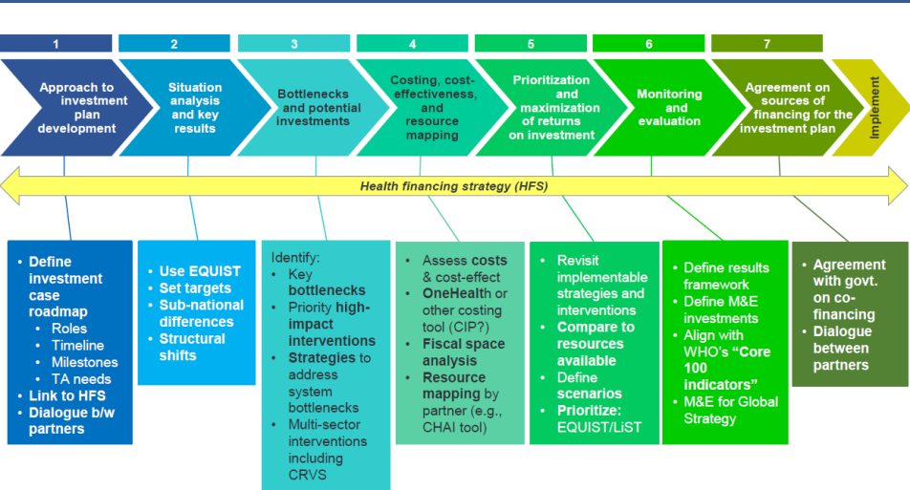
Obtaining grant funding requires an investment case (IC). The development process vary from country to country, but strong ICs all share common elements:
Inclusive Country Dialogue
Focus on Results
Detailed financial gap analysis
Strong M&E Framework
Articulated Health Financing Strategy
Coherent Approach
Attention to equity, efficiency, structural shifts
Explicit Prioritization
Complementary financing
Indicative flow chart depicting standard process
How can Malawi tailor a process that is appropriate to its health sector context, evidence to date, and timelines?
Notes:
Coherent Approach: In many countries, a number of plans have been developed to address different parts of the RMNCAH continuum, which results in a lack of coherence across the RMNCAH spectrum. Additionally, in many countries, some highly effective (and cost-effective) interventions (e.g. family planning, nutrition) and some key target audiences (e.g. adolescents) are neglected in existing plans.

Slide 7
Step 1: Determine Approach
Agree on what basis and form the Investment Case (IC) should take
Activities
Collect existing strategies that are relevant to IC (e.g. HSSP II, SRH, FP, YFHS, Health Financing Strategy)
Draft approach and workplan, including intermediate outputs and interactions among them
Undertake extensive stakeholder analysis
Agree on design of country platform and draft stakeholder engagement strategy
Outputs
1. Investment Case Roadmap
Timeline and Milestones
Costed TA needs
Clarity on linkage to Health Financing Strategy
2. Stakeholder Engagement Strategy and Country Platform Design

Slide 8
Step 2: Analyze situation and agree on results
Collect and analyze data on RMNCAH+N situation
Agree on the results/milestones/targets to be achieved with IC
Activities
Collect and analyze both existing and new data (as needed) on RMNCAH+N interventions/outcomes
Focus on equity, efficiency, multi-sectoral determinants, and upcoming structural shifts
Prioritize results: Determine which aspects of the RMNCAH continuum and the health system to focus on
Define Targets: Determine where the country wants to go until 2030, including 3-5 year targets and how trajectory differs from the status quo
Outputs
Analytical outputs as defined in workplan
Agreement on result areas, 2030 targets, 5-year milestones
Notes:
This involves determining which aspects of the RMNCAH continuum and/or the health system that the country wishes to focus on (e.g., maternal health, newborn health, human resources for health, supply chain management) and then describing both where a country is starting with on these aspects (e.g. the baseline) and where it wants to go over the next 15 years (aligned with the SDG timeframe). It should include concrete targets for the initial period of 3-5 years, and should clearly articulate how the desired trajectory differs from the status quo.

Slide 9
Step 3: Bottleneck Analysis and Potential Investments
Refine and amend HSSP II/other strategies based on 2030 goals
Activities
Identify key bottlenecks (e.g. EQUIST)
Identify priority high-impact interventions (e.g. LiST)
Develop core strategies to address system bottlenecks
Develop multi-sector interventions, including CRVS
Outputs
Articulated list of bottlenecks (RMNCAH+N specific and system-wide)
Articulated strategy of strategies and interventions to address them, including strong justification
Refined or amended HSSP II/other strategies to incorporate the above elements (refer to initially-agreed IC basis )

Slide 10
Step 4: Costing, Cost Effectiveness, and Resource Mapping
Assess costs/cost-effectiveness of proposed interventions
Map resources potentially available for the above costed need
Activities
Cost draft strategies and interventions (including multisectoral components) – could be based on previous costings
Retrieve Resource Mapping Round 5 data on RMNCAH+N total projected resources available
Outputs
Costed interventions and strategies
Resource availability analysis against costs (i.e. financial gap analysis)

Slide 11
Step 5: Prioritization and Maximization of Returns on Investment
Identify priority interventions and strategies that can be implemented within the available resources
Activities
Prioritize wishlist of strategies and interventions to create a financially realistic proposal
Explore efficiency opportunities to reduce costs of proposed strategies and interventions
If appropriate, scenario analysis with different sets of interventions, strategies, and scale-up
Outputs
Clear set of prioritized strategies and interventions that fit within resource envelope

Slide 12
Step 6: Monitoring and Evaluation
Define results framework approach for monitoring and evaluating progress
Activities
Develop results framework and indicators for monitoring and evaluation, including M&E of financing
Identification of key investments required for M&E (including CRVS)
Outputs
3-5 year Results Framework
List of key indicators
M&E implementation plan, including investment planning

Slide 13
Step 7: Mobilize, Pool, and Coordinate Resources for IC
Agreement among government agencies and partners on the financing of the Investment Case
Activities
Conduct detailed resource mapping and gap analysis to identify over- and under-funded areas of the IC
Secure domestic commitments for plan
Secure external commitments for plan
Outputs
Documentation of high-level agreement among:
Government and partners
Government agencies (MoF, MoH, and other MDAs)
Detailed investment framework mapping out IC funding status and commitments

Slide 14
Step 8: Draft Investment Case
Document and finalize the Investment Case for submission
Activities
Identify documentation requirements of IC
Develop outline and components of IC
Write up technical components of IC
Finalize cost/quantitative components of IC
Circulate for feedback and finalize
Outputs
Completed and validated investment case package for submission to WB/GFF Trust Fund Board Committee

Slide 15
Nov
Jan
Nov
Dec
Feb
Design stakeholder engagement strategy and Country Platform (CP)
Engage stakeholders via CP
LAUNCH MEETING
Determine approach
through govt-partner dialogue
Update situation assessment
Using existing strategies and latest data (epi, population, HSS, etc.)
Assess TA needs
against workplan
Supplement with analyses
(e.g. equity, efficiency, multi-sectoral determinants, demand-side factors, etc.)
Agree on goals, including 2030 targets, and 3-5 year milestones
Identify bottlenecks and priority interventions to address them (RMNCAH+N and systems strengthening; health and multi-sector)

Slide 16
Mar
May
Nov
Apr
June
Continued stakeholder engagement via Country Platform
Validate high-level resource envelope for RMNCAH+N
IC SUBMISSION
Update costs for priority strategies and interventions (including multi-sector approaches)
High-level gap analysis:
Total Resources – Total Costs = Gaps
PRIORITIZE
High-impact interventions
Detailed gap analysis
Identify over- and under-funded areas
Conclude negotiations
Secure commitments
onto largest gaps (domestic + external)
Draft Investment Case
Finalize IC

Slide 17
SWOT Analysis: Strengths
Existing relevant national strategies and plans with RMNCH components or focus
Useful multi-stakeholder engagement platforms
Engagement of the private sector – CHAM through Service Level Agreements
EQUIST updated to 2015
Preliminary situation analyses informed development of new national strategies

Slide 18
SWOT Analysis: Weaknesses
Incomplete situation analysis (in terms of equity, efficiency, multi-sectoral determinants and demand side factors)
Current approaches are limited to health sector with little attention to multi-sectoral determinants
No RMNCAH+N-focused resource mapping
Low domestic financing for health and low potential for expansion
Limited involvement of the private sector (apart from CHAM) in strategic planning

Slide 19
SWOT Analysis: Opportunities
Political will at Presidency and Ministry of Health: Minister of Health prioritizes aid coordination for RMNCAH and civil registration and vital statistics;
Leverage existing strategies and policies to develop investment case
Leverage existing health financing reforms to finalize a comprehensive health financing strategy
Leverage existing government-led collaborative platforms to create the GFF Country platforms.
Prioritize RMNCAH+N in EHP Implementation

Slide 20
SWOT Analysis: Threats
Unpredictable political economy with upcoming elections
Bureaucracy in review and approval of investment case and strategy
Delayed negotiation with Treasury on terms of IDA finance
Non-alignment of country priorities with World Bank expectations
Supply chain management issues – drug pilferage
Implementation challenge with decentralization

Slide 21
Immediate Steps from now through December 15
Agree on Basis of Investment Case
Collect, validate, and review existing strategies, policies, and evidence to inform situation analysis
Agree on which/how the above evidence will be used to form basis of investment case
Planning:
Validate draft workplan with roles and responsibilities, cost it, and identify TA needs
Plan and mobilize partner TA through IC submission
Stakeholder Engagement:
Map stakeholders, develop engagement strategy, and design country platform
Plan for Global Financing Facility Launch in January 2018

Slide 22
Stakeholders
Government –MoH,MoF,Education,Gender and Agriculture.
Multilateral institutions
WHO, UNICEF, UNFPA, World Bank, EU
International organizations
Global Fund
Bilateral donors
USAID, DFID, GIZ, SIDA…
NGOs-Local and International
Civil society-Local and International
Private sector-CHAM and Others
Others?

Slide 23
Strategy/Policy Mapping – for discussion
Malawi Growth and Development Strategy
Health Sector Strategic Plan II
Community Health Strategy
Reproductive Health Strategy (Draft)
Roadmap for Accelerating the Reduction of Maternal and Neonatal Mortality in Malawi
Every Newborn Action Plan: An Action Plan to end Preventable Deaths in Malawi
Malawi Costed Implementation Plan for Family Planning
IMCI Approach Policy for Accelerated Child Survival and Development
Youth Friendly Health Services Strategy
Child Health Strategy
Others?

Slide 24
Draft Roadmap Progress as of June 2018
Finalize and validate the roadmap and submit to GFF and World Bank: to submit for inputs by week from 18th, June
Full time Coordinators (2) of the overall process co-financed by UNICEF, WB, BMGF by end June
Unicef Regional office to share information from on investment case ( IC )from other GFF countries (Mozambique, Kenya, Uganda) by end June
All groups- Internal (MNH, Child Health, WASH&Nutrition) to finalize Equist scenarios (prioritized districts, rest of the country) --- by end June
Launch of the GFF Roadmap (early July)
Non-Equist (Adolescent/SRH, NCD, investment in early years, decentralized registration/CRVS, Enabling Environment): engage the right stakeholders --- by Agriculture, Education, Gender, Youth; (early July),
Obtain draft working areas (revised ToC) (early July)
Health financing strategy : MoH and MoFA (July)
MoH to organize consultative workshop to finalize prioritization scenarios (mid July)
Write up (start by end of July and early August 2018)
Submission September 2018

Slide 25
Examples Some CSOs Platforms Roles
Facilitate coordination of CSOs to enhance information sharing for advocacy in relation to the implementation of the Investment Case for RMNCAH + Nutrition.
Strengthen and capacity building of CSOs, and other stakeholders regarding the implementation of the Investment Case.
Coordinate the development of the engagement strategy and follow up for accountability; and
Support the development of relevant accountability tools and processes.

Slide 26
Thank you

