Slide 1
Key Tools & Resources for Enhancing Civil Society Engagement in the GFF
July 23, 2018
Susannah Hurd
Vice President Global Health Visions
Interim Coordinator, GFF CS Coordinating Group, hosted by PMNCH

Slide 2
Key Tools for CSOs and Other GFF Stakeholders
Civil Society Engagement Strategy (CSES)
  CSES Implementation Plan
  Youth Addendum
Guidance Note on Inclusive Multi-stakeholder Country Platforms in Support of Every Woman Every Child
Civil Society Guide to the GFF
CSO Coordinating Group & Steering Committee
  Google group, webinars, AHBN newsletter
GFF Country CSO Partner Mapping
Notes:
These are all important tools for civil society, and also tools that other GFF partners should use – i.e. the Guidance Note, which is for all the partners on the country platform, and the CSES, which includes roles and responsbilities for country governments, global actors etc.

Slide 3
1. Civil Society Engagement Strategy (CSES)
GOAL: Civil society is meaningfully engaged in the GFF, from sub-national to national to global levels, such that the full breadth of their skills and expertise can contribute to determining and achieving mutual goals and targets, including those laid out by the GFF and GFF countries, the Global Strategy for Women’s, Children’s and Adolescents’ Health, and the Sustainable Development Goals.
Notes:
The civil society engagement strategy was developed through a broad consultative process
Gathering input from nearly 250 partners from 28 countries from Nov 2016 to March 2017
GOAL: Civil society is meaningfully engaged in the GFF, from sub-national to national to global levels, such that the full breadth of their skills and expertise can contribute to determining and achieving mutual goals and targets, including those laid out by the GFF and GFF countries, the Global Strategy for Women’s, Children’s and Adolescents’ Health, and the Sustainable Development Goals.
OBJECTIVE: GFF stakeholders will agree and act upon a clear set of roles and responsibilities for enhancing civil society engagement in the GFF, that contribute to improved GFF systems and processes at all levels, with particular focus on countries, including development, implementation, and accountability for GFF country investment cases and health financing strategies.
CROSS-CUTTING PRINCIPLES
Results: Maintain focus on the achievement of measurable results in support of GFF and country goals.
Though the CSES and Implementation Plan are process-focused, these processes and structures are proposed as critical building blocks to ensure the CSOs are set up to be successful in achieving results.
Country context specificity leadership: Ensure that CSOs in GFF countries develop context-specific action plans to guide their work in support of country investment cases.
The CSES and Implementation Plan provide a framework for the structures and processes that should be in place across all GFF countries, but CSOs will determine their own results-oriented action plans to support the achievement of common goals that align with each country’s investment case
Inclusiveness, Transparency, and Accountability:
Ensure that these principals from the Guidance Note on Inclusive Multi-Stakeholder County Platforms are also integrated into national CSO platforms
Engagement of local and grassroots CSOs, youth, and representatives of marginalized and vulnerable populations, including those from fragile contexts:
Elevate their voices and support their participation in political and decision-making processes
Alignment with other global health initiatives in-country:
In GFF countries, ensure alignment among civil society supported by other Global Health Initiatives (GHIs) to promote efficient use of resources and time, and achievement of common results

Slide 4
CSES Strategic Approach
The strategic approach is grounded in three objectives:
COUNTRY PLATFORMS are supported to meaningfully engage civil society in support of common goals, through use of the Guidance Note: Inclusive Multi-stakeholder Country Platforms in Support of Every Woman Every Child
CSO COALITIONS AT NATIONAL AND GLOBAL LEVELS are strengthened to enhance civil society alignment and capacity, and to streamline communications and technical assistance
GFF ACCOUNTABILITY is strengthened through support for civil society’s role in accountability, and increased transparency and space for accountability in GFF processes
Notes:
NOTE: the systems and processes outlined in the CSES for enhancing CSO engagement in the GFF are essential building blocks so that CSOs can effectively support GFF goals and country investment cases, through a variety of roles, depending on each country’s context and priorities

Slide 5
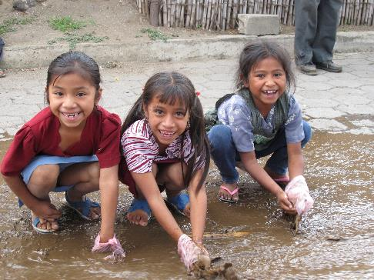
The Value of Civil Society to RMNCAH+N
CSOs contribute to tangible outcomes and results for RMNCAH. Each of these “functions” can be leveraged in support of National Investment Cases, GFF goals, and the Global Strategy:
Advocacy
Monitoring and Accountability
Elevating Voices of Affected Populations
Implementation
Research & Data Analysis
Technical Assistance

Slide 6
CSES Implementation Plan
  Provides an operational framework for implementing the CSES. For each objective of the CSES, the implementation plan outlines key expected outcomes, outputs, and recommended activities for CSOs.
Objective 1
Country Platforms are supported to meaningfully engage civil society, in support of common goals, through implementation of the Guidance Note
Objective 2
CSO Coalitions at national and global levels are strenghtened to enhance civil society alignment and capacity, and to streamline communication and technical assistance
Objective 3
GFF accountability is strengthened through capacity strengthening and support for civil society’s role in accountability, and increased transparency and space for accountability in GFF processes.
Outcome 1.1
Government and other Country Platform members recognize civil society’s role in influencing policy, planning and implementation of GFF investment cases
Outcome 1.2
CSOs meaningfully participate in and influence policy, planning, resource mobilization, and implementation of GFF investment cases at national and sub-national levels.
Outcome 2.1
National RMNCAH coordination mechanisms for CS are established and/or strengthened, in support of the GFF, with strong alignment & coordination w/ other CSO platforms (e.g. GAVI, Global Fund, SUN, UHC2030); actions plans are put in place to increase impact of their work
Outcome 2.2
Outcome 2.2: CSOs engagement in the GFF at all levels is supported by the global GFF CSO Coordinating group, and is aligned with civil society engagement efforts in other relevant global initiatives and financing mechanisms (e.g. Gavi, Global Fund, UHC2030, SUN).
Outcome 2.3
Global health initiatives, the private sector and donors support national civil society priorities by streamlining and leveraging their resources through a harmonized and coordinated joint funding mechanism
Outcome 3
CSOs are recognized and engaged as critical independent players in ensuring accountability for the GFF; CSO capacity to implement successful accountability mechanisms is strong

Slide 7
Cross-Cutting Principals
Results: Maintain focus on the achievement of measurable results in support of GFF and country goals.
Country context specificity and leadership: CSOs in GFF countries develop context-specific action plans in support of country investment cases.
Inclusiveness, Transparency, and Accountability: The principals from the Guidance Note on Inclusive Multi-Stakeholder County Platforms are also integrated into national CSO platforms
Engagement of local and grassroots CSOs, youth, and representatives of marginalized and vulnerable populations, including those from fragile contexts: Elevate their voices and support their participation in political and decision-making processes
Alignment with other global health initiatives in-country: Strengthen alignment among civil society supported by other Global Health Initiatives (e.g. Gavi, Global Fund, Fp2020, UHC2030 etc.) to promote efficient use of resources and time, and achievement of common results
Notes:
Results: Maintain focus on the achievement of measurable results in support of GFF and country goals.
Though the CSES and Implementation Plan are process-focused, these processes and structures are proposed as critical building blocks to ensure the CSOs are set up to be successful in achieving results.
Country context specificity leadership: Ensure that CSOs in GFF countries develop context-specific action plans to guide their work in support of country investment cases.
The CSES and Implementation Plan provide a framework for the structures and processes that should be in place across all GFF countries, but CSOs will determine their own results-oriented action plans to support the achievement of common goals that align with each country’s investment case
Inclusiveness, Transparency, and Accountability:
Ensure that these principals from the Guidance Note on Inclusive Multi-Stakeholder County Platforms are also integrated into national CSO platforms
Engagement of local and grassroots CSOs, youth, and representatives of marginalized and vulnerable populations, including those from fragile contexts:
Elevate their voices and support their participation in political and decision-making processes
Alignment with other global health initiatives in-country:
In GFF countries, ensure alignment among civil society supported by other Global Health Initiatives (GHIs) to promote efficient use of resources and time, and achievement of common results

Slide 8
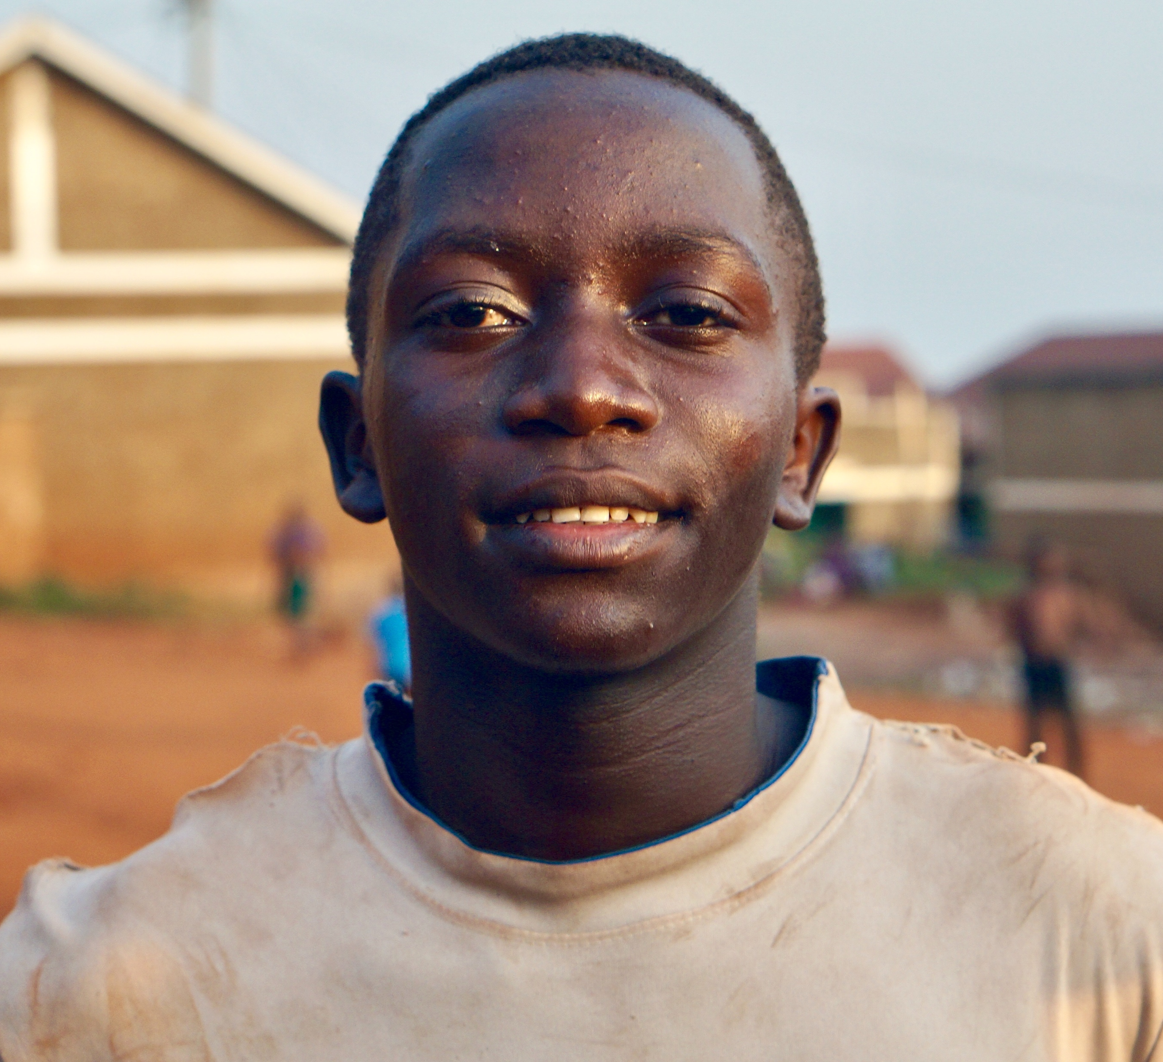
Adolescents & Youth Addendum to the CSES
To further recognize, strengthen, and delineate the critical role of young people and youth-led organizations in supporting the GFF at global and national levels.
Global representation
Knowledge sharing & capacity building
Youth in national CSO action plans
Multi-stakeholder country platforms
Accountability
Notes:
Global representation: All youth organizations are invited to joint he GFF Civil Society Coordinating Group, and two youth representatives are part of the Steering Committee (discussed later). In addition there is a designated youth seat and alternate on the GFF Investors Group, in addition to the two civil society seats on the IG (and two alternates).
Knowledge sharing & capacity building: Young people can obtain further information and capacity strengthening support for participating in the GFF process through knowledge-sharing, webinars, periodic mentoring, and a bi-monthly newsletter hosted by the CS Coordinating Group and CSCG partners. Opportunities for the youth IG rep and other young people representing youth organizations should be provided via these platforms to promote information sharing and learning. Special efforts will be made to reach out to young people to ensure their awareness of and engagement in these knowledge sharing and capacity building platforms, and to explore additional ways to support engagement and exchange across countries, such as a blog.
Youth in national CSO action plans: Explicit recommendations will be made to include youth networks in CSO coalition activities, CSO action plans for the GFF, as well as in country coalition leadership.
Multi-stakeholder country platforms: The Steering Committee will engage GFF stakeholders to ensure that implementation of the Guidance Note: Inclusive Multi-stakeholder Country Platforms in Support of Every Woman Every Child emphasizes the minimum standard around inclusion of youth in the country platform, and in the development, implementation, monitoring and review of the country’s Investment Case and Health Financing Strategy.
Accountability: An accountability working group of the CSCG will include youth representative(s) with a view to identify youth-led organisations to develop and implement and/or participate in accountability activities, particularly at the country level.

Slide 9
2. Guidance Note: Inclusive Multi-stakeholder Platforms in Support of EWEC
Aims to:
To highlight how multi-stakeholder country platforms, built on development effectiveness principles, in line with the globally agreed recommendations of IHP+, can be reinforced within the framework of the Global Strategy and its supporting mechanisms and are key to the Global Strategy’s successful implementation.
To lay out key considerations for new multi - stakeholder country platforms, along with the relevant mechanisms and a minimum set of standards to support the process of national coordination among actors engaged in RMNCAH

Slide 10
Guidance Note: Principals and Minimum Standards
Inclusiveness
Transparency
Accountability
Leadership by the Ministry of Health
Notes:
The guiding principles of the multi - stakeholder country platform are aligned with globally agreed development effectiveness principles and include:
Leadership by the Ministry of Health
Inclusive and meaningful participation, engagement and decision making with country stakeholders at relevant levels, including local, national and international civil society organizations, academia, private sector and other development partners influencing the RMNCAH agenda;
Transparency, communication and openness of the process to ensure mutual accountability amongst all stakeholders , within and outside the multi-stakeholder country platform . This includes timely access to information such as meeting minutes and key reports from the multi-stakeholder country platform that can support understanding of decisions reached including financial information
Joint monitoring of processes, implementation and results based on harmonized information and accountability , including, where appropriate, joint annual reviews and reporting that define actions that are implemented and reinforce mutual accountability. Mutual accountability is needed for the efficient and effective functioning of the multi-stakeholder country platform.
Minimum standards for inclusiveness, transparency, and accountability are included in Annex 2 of the Guidance Note, and we encourage Civil Society to work the the MoH and other Development Partners, to ensure that those minimum standards are implemented.
These same minimum standards should also apply to CSO platforms in countries.

Slide 11

3. Civil Society Guide to the GFF
Commissioned by the Civil Society Coordinating Group to help CSOs working in GFF countries understand and meaningfully engage in the various stages of the GFF
https://pai.org/reports/civil-society-guide-gff/
Notes:
This is a key resource for civil society to understand:
How the GFF works
The governance structures of the GFF at the global and country levels
Opportunities for CSOs to engage in the GFF
Key support structures in place for civil society, including the CSO Coordinating Group – which any and all civil society organizations are welcome to join
Available in English, French, and Portuguese

Slide 12

4. GFF CSCG hosted by PMNCH
Civil society from global, regional, national, and sub-national levels that align their resources and actions to ensure meaningful engagement of CS in the GFF at the international level, and provide support to CS working in GFF countries…
…so that the full breadth of CS skills and expertise can be leveraged in support of mutual goals and targets (as laid out by EWEC, GFF, and country plans)
To join, email: susannah.hurd@ghvisions.com

Slide 13
4. GFF CSCG hosted by PMNCH
Three CSCG Working Groups:
Accountability
Health Financing
Capacity Building and Country Engagement
To join, email: susannah.hurd@ghvisions.com
Notes:
Members of GFF CSCG working groups:
Representatives of organizations or individuals leading or focused on issues related to the working group focus area (accountability, capacity building/country engagement, health financing).
Must be able to commit to attending regular calls, at a cadence determined by the working group (no less than one 1-hour call per month, and no more than two 1-hour calls per month).
Must be able to contribute additional time for drafting and editing documents, case studies, tools, and other written resources; and/or providing direct 1:1 outreach to CSOs in GFF countries. An estimated commitment of 3-5 hours per month.
Must be comfortable and proficient communicating in English.*
In addition, each working group will consist of:
At least one, preferably more, youth representatives and/or representatives of youth organizations.
No more than two representatives per organization; if an organization has two representatives on a working group, one should be a “global” representative, and one should be a “country” representative.
No more than 3 CSOs from the same GFF country. If more than 3 representatives from a country express interest in being part of a working group, the decision will default to the primary GFF CSO coalition in that country to select or nominate 3 working group participants through a transparent process.
CSCG members interested in joining a working group should submit a short statement of interest and commitment (1-2 paragraphs) to the CSCG Coordinator (susannah.hurd@ghvisions.com), to be reviewed and approved by the Steering Committee and the chair(s) of the designated working group.

Slide 14
CSCG Communication & Information Sharing
Google Group: This is our main source of communication. At minimum, there will be quarterly updates provided to the google group, and it is a space for partners to provide updates and share tools & resources
Webinars: These occur at least 4 times a year, before and after each Investors Group meeting in April and November. Additional webinars are sometimes scheduled on particular topics.
AHBN bi-monthly newsletter: Sign up for the Africa Health Budget Network list-serve and you will also get this bi-monthly newsletter with global, regional, and country updates on the GFF

Slide 15
CSCG Steering Committee
Country CSO Representatives
Johnpaul Omollo, HENNET, Kenya
Fogue Foguito, Positive Generation, Cameroon
Moussa Mane, ASBEF, Senegal
Victor Koroma, Health Alert, Sierra Leone
Emmanuel Diavisi, National Council of Health NGOs, DRC
Global / Regional Representatives
Aminu Garba, AHBN, Nigeria – IG representative
Angela Mutunga, AFP-Jhpiego, Kenya – IG representative
Chris Armstrong, PLAN Canada – IG rep alternate
John Townsend, Population Council, USA – former IG rep alternate
Joanne Carter, RESULTS, USA – former IG rep
Mefin Teklu, IRC, Ethiopia – former IG rep
Patson Malia – Youth rep to the IG
Joannie Bewa – Youth rep
Kadi Toure, PMNCH, Senegal
Suzanna Dennis, PAI, USA
Betsy McCallon, White Ribbon Alliance, USA
Supporting Consultants
Susannah Hurd, Global Health Visions, USA
Maty Dia, Independent Consultant, Senegal
Notes:
The Steering Committee is responsible for developing advocacy objectives and strategies, soliciting feedback with the wider membership, fundraising, initiating meetings, and leading engagement with the GFF Secretariat.
The members include:
5 country CSO representatives selected annually, with particular emphasis will be given to individuals who sit on the GFF Country Platform
CS representatives and alternates to the IG, as well as previous CS representatives to the IG
A focal point from the PMNCH Secretariat
A designated representative from PMNCH’s CS constituency
1-2 support people

Slide 16
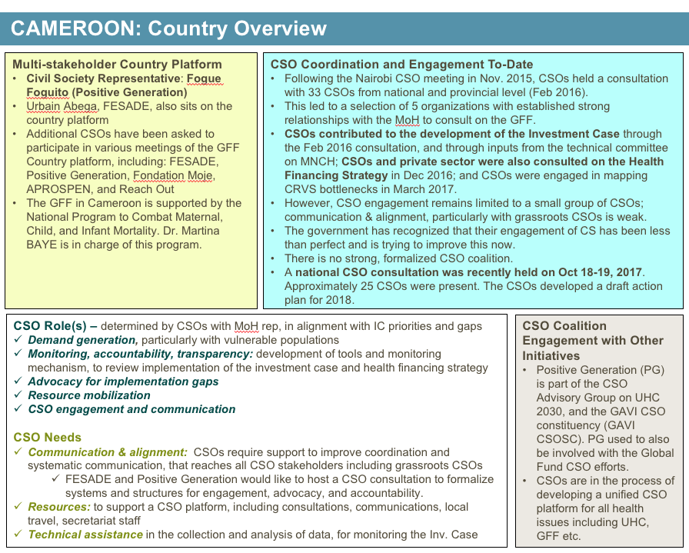
5. GFF Country CSO Partner Mapping
Notes:
The CSO Country Partner mapping
The mapping provides a snapshot of what is happening in each GFF country with respect to CSO engagement, CSO roles in support of GFF goals and country Investment Cases, and CSO needs.
It also highlights key CSOs that have been engaged in the GFF process to-date in each GFF country.
This is a living document and we need your help to ensure that partners across countries, and at the regional and global levels have an accurate picture of key processes, results, roles, or needs of civil society, related to the GFF; and about alignment with CSO efforts around other global health initiatives (e.g. UHC2030, SUN, Gavi, Global Fund).
We want to know what you and your CSO partners are doing related to the GFF in your country, so please keep us informed by email or reach out to me or one of the other Steering Committee Members to tell us.

